Slide 1



LESSON 3.4
DATA FLOW DIAGRAM
Presentation

Slide 2
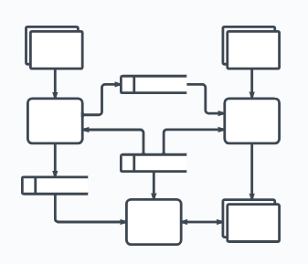
Introduction
What is DFD or Data Flow Diagram?

Slide 3
Based in the article “Business Process Modelling Techniques with Examples” by Nishadha (2020), Data flow diagrams (DFD) show the flow of data or information from one place to another.
DFDs describe the processes showing how these processes link together through data stores and how the processes relate to the users and the outside world.

Slide 4

Four Main Elements of Data Flow Diagram

Slide 5
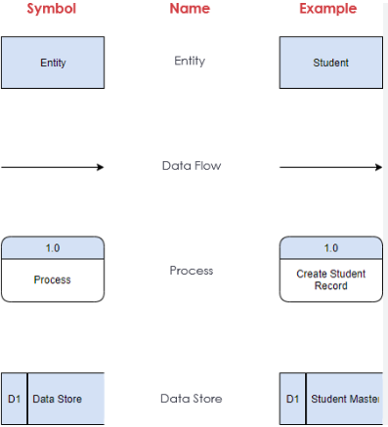

Slide 6
1
External Entity
External Entity - known as actors, sources and terminators, external entities produce and consume data that flows between the entity and the system being diagrammed.
(Where data comes from or goes to)

Slide 7
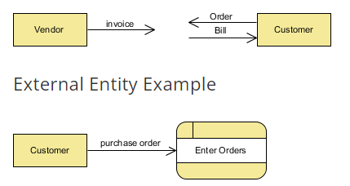

Slide 8
2
PROCESS
Process – it is an activity that changes or transforms data flows. Since they transform incoming data to outgoing data, all processes must have inputs and outputs on a DFD.
(What the system does)

Slide 9
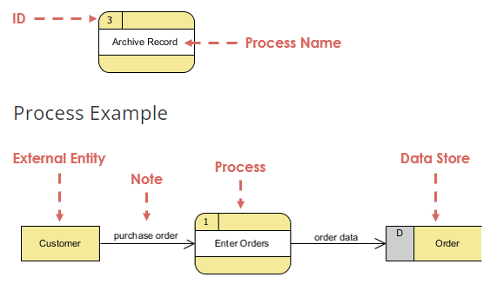

Slide 10
3
DATA STORE
Data Store - represents the storage of persistent data required and/or produced by the process. Here are some examples of data stores: membership forms, database tables, etc.
(Where the data is kept)

Slide 11
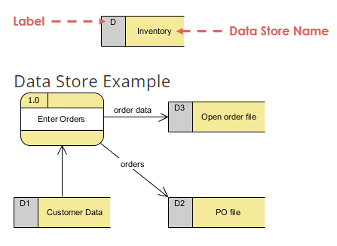

Slide 12
4
DATA FLOW
Data Flow – represents the movement of data between external entities, processes and data stores is represented with an arrow symbol, which indicates the direction of flow.
(How data moves)

Slide 13
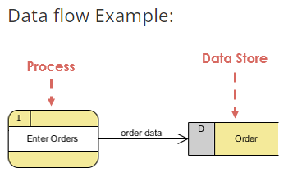

Slide 14
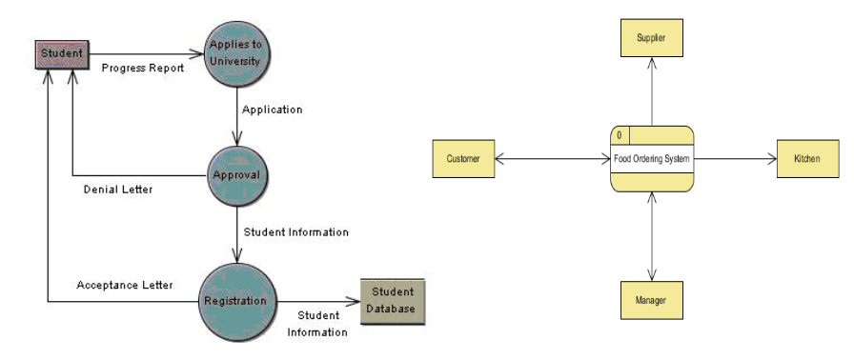

Slide 15
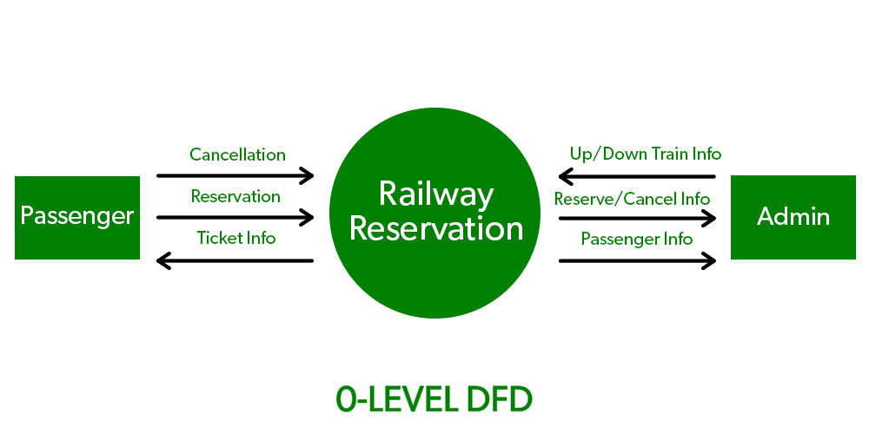
LEVEL 0
DFD Level 0 is also called a Context Diagram.

Slide 16
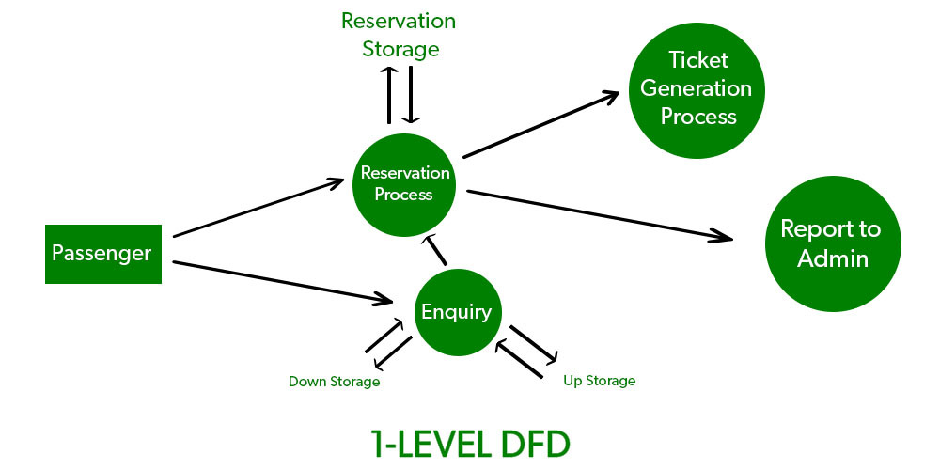
LEVEL 1
DFD Level 1 provides a more detailed breakout of pieces of the Context Level Diagram.

Slide 17
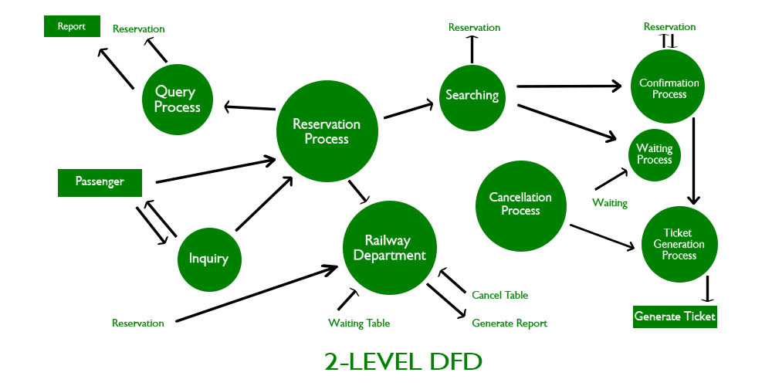
LEVEL 2
DFD Level 2 goes one step deeper into parts of Level 1. It may require more text to reach the necessary level of detail about the system’s functioning.

Slide 18
THANKYOU

